Slide 1
115th New England Restructuring Roundtable
March 12, 2010
Revisiting transmission & renewables
Ignacio J. Pérez-Arriaga
IIT, Comillas University
CEEPR, MIT

Slide 2
EU & US Information for a comparison

Slide 3
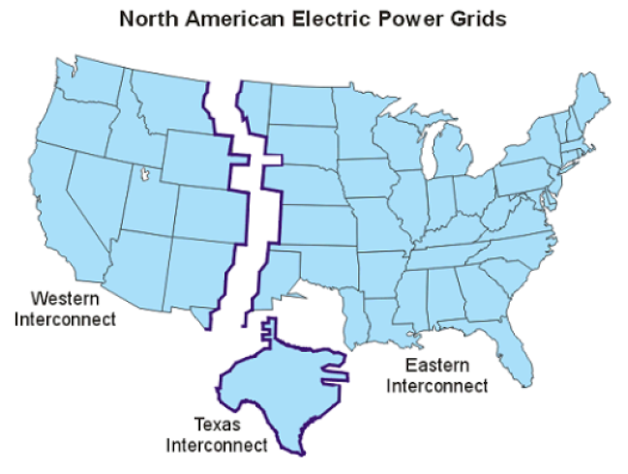

Slide 4
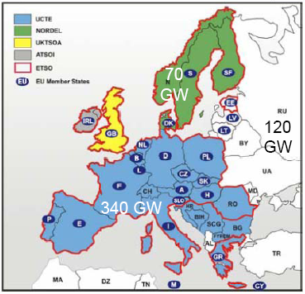
Synchronous subsystems in Europe

Slide 5
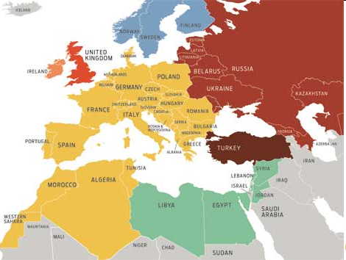
Synchronous blocks & broader perspectives (e.g. the “Mediterranean Ring”)
Notes:
BUILDING BLOCS: The electrical grids of Europe, North Africa, and the Middle East form different synchronous blocs. Western North Africa is already tied to Europe’s Union for the Co-ordination of Transmission of Electricity [yellow In 2009, Libya, Egypt, Jordan, Syria, and Lebanon [green] may join that bloc. Energizing existing linkages to Turkey [brown] would then close the Mediterranean Electricity Ring.

Slide 6
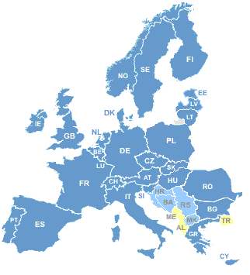
The Internal Electricity Market (IEM) of the EU
Notes:
From ETSO Adequacy Report 2010-2020, written in 2008.
The networks represented by ETSO supply more than 490 million people with electric energy. The consumption of electric energy amounts to approx. 3200 TWh per year. The length of HV (400 and 220 kV) lines covered by ETSO is of more than 290 000 km.
In 1999, ETSO was created as an association with ATSOI, UKTSOA, NORDEL and UCTE as founding association members. However, on 29 June 2001 ETSO became an International Association with direct membership of 32 independent TSO companies from the 15 countries of the European Union plus Norway and Switzerland. At the end of 2001 ETSO membership was enlarged to Slovenia and CENTREL countries as full and associate members respectively. The Czech Republic was admitted as full member in June 2003 and Hungary, Poland and Slovakia in 2004.The Estonian TSO has become ETSO Associate Member in September 2004 and the Lithuanian TSO in February 2005. The Rumanian TSO is ETSO Full Member since November 2004 and the Cyprus TSO since September 2005. The Lithuanian TSO has become Full Member in November 2005. The Estonian & Latvian TSOs have been welcomed as Full Members in December 2005. Serbia, Bosnia Herzegovina, Croatia and FYROM are Associate Members of the Association. Bulgaria is Full Member since September 2007.

Slide 7
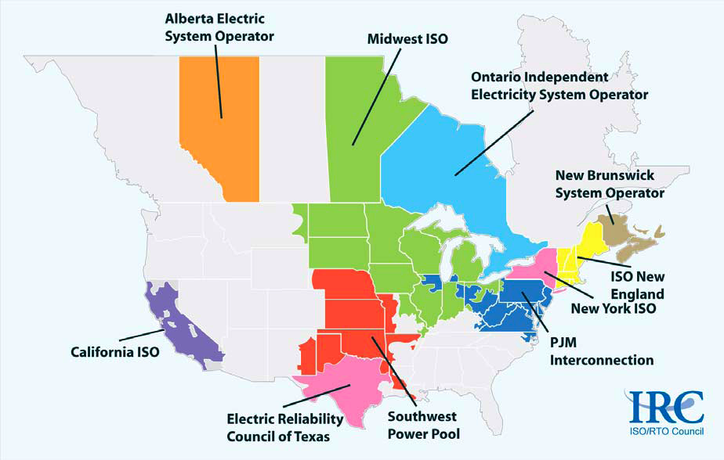
Notes:
See http:// www.iso-rto.org

Slide 8
US & EU: a basic comparison
EU-27 & IEM
4,3 Mkm2, 493 Mhab, 11600 b€ GDP
741 GW installed capacity
3309 TWh/year
(Installed capacity, annual production)
Germany (124 GW, 620 TWh)
France (116 GW, 578 TWh)
UK (81 GW, 398 TWh)
Italy (85 GW, 304 TWh)
Spain (70 GW, 294 TWh)
USA
9,8 Mkm2, 300 Mhab, 13200 b$ GDP
1076 GW installed capacity
4200 TWh/year
(Installed capacity, annual production)
PJM (164 GW, 763 GWh)
MISO (127 GW, xxx)
ERCOT (80 GW, 290 TWh)
California (55 GW, 240 TWh)
NY-ISO (40 GW, 167 TWh)
NE-ISO (31 GW, 134 TWh)

Slide 9
The issues

Slide 10
The unrelenting transmission issues (even without renewables!!)
What projects? Geographical scope? Who decides? On what basis?
How much return on investment? From tariffs? From contracts? From LMPs?
Who pays? On what basis?
Whose backyard?
How much operational coordination is desirable?

Slide 11
First… some theory

Slide 12
3 dilemmas in transmission
Planning: Should transmission be planned with an ISO-like geographical scope or rather with an interconnection-wide scope?
Cost allocation: In case long transmission lines are built to connect far away generation to major load centers: Should these network costs be charged to those generators? Also to the loads that have purchased this power? More broadly to all who “benefit”? Socialized?
Cost recovery: Should the initiative to build these lines be left to the incumbents? To any investor? Should some default investor be designated? How should the cost be recovered?

Slide 13
Facts & principles (1 of 3)
Anticipated massive deployment of renewables is forcing transmission planners to look beyond the customary ISO-like range
About trade:
When Chile exports fruit or wine the price of fruit & wine rises in Chile for everybody (& decreases in the importing country also for everybody) not just for the people involved in the transaction
“Transmission charges should not depend on commercial transactions”

Slide 14
Facts & principles (2 of 3)
An “economic” transmission investment is one that results in more benefits for the network users (or equivalently, in less incurred costs of supply) than the total cost of the investment
Unless the margin “benefits – costs” is very large, an incorrect allocation of the cost (e.g. missing 50% of the beneficiaries) will create opposition in those who are told to pay

Slide 15
Facts & principles (3 of 3)
Differences in locational marginal prices (LMP) (or any contracts that are based on these differences) in general markedly under-recover (barely 20% of total) the transmission costs once the investment is in place
Contract-financed investments will be the exception, unless
the investment is insufficient to reduce the price differential
or the contracts are very long-term
or the line joins two clearly differentiated areas
& beneficiaries are not widely dispersed so it is possible to negotiate
& no other future investments with the same function are expected that will destroy the price differential
Similar considerations apply to lines built by coalitions of network users

Slide 16
Then… orthodox answers
Interconnection-wide transmission planning has to be attempted, despite all difficulties
The “inspiring principles” of transmission cost allocation are:
both generators & consumers should pay
transmission charges should be levied on all who benefit, not only on those who trade
use a proxy to “benefits”, such as some measure of “network utilization”
Unless there is a back-up of default investor under ISO-tariffs
some economically justified lines will be left non built
of those built under contracts probably the network users will be paying more than under an ISO-tariff regime
Notes:
Explanation of the last statement: A merchant line that does not destroy the price difference may charge for almost the price difference. If the line is well economically justified, this may be much more than the cost of the line. Under cost-of-service regulation the network users only pay for the cost of the line.

Slide 17
EU energy policy

Slide 18
EU energy policy
The EU has recently established important regulation
Reduction 2020/1990 of CO2 emissions by 20% (30% if international consensus) plus GHG Emission Trading
Target of 20% of renewables in final energy consumption (thus approx. 40% of electricity production)
Creation of the Agency for Cooperation of Energy Regulators (ACER) & the European Network of TSOs for Electricity (ENTSO-E)
Still no executive power by ACER to approve regulation, & ENTSO has no regulation competence, but at least there will be institutions with true EU-wide mission & scope, & the technical capability & adequate internal procedures to produce meaningful proposals

Slide 19
EU energy policy on renewables
The dilemma of global (EU-wide) efficiency versus local (national) advantages
Solution: National schemes plus EU-wide trade.
National schemes may prevent to attain a good level of EU-wide efficiency. But they are the outcome of lengthy regulatory efforts and, when successful, it would be a big loss to scrap them.
A good compromise is to let countries keep their specific national approaches, whatever they are, and then letting them trade at EU level any deficits or surpluses.
Those countries who do not want to have a national program with specific objectives, they just let investment happen in their territory and then buy and sell the allowances for any deficits or surpluses.

Slide 20
Transmission network expansion planning siting cost recovery cost allocation

Slide 21
The challenge…
Despite the large geographical dimension of the EU IEM & open transmission access, there are not very significant transfers of electricity between regions
The interconnections between regions are frequently weak
Typically there are no major surpluses / deficits
Generation technologies at the margin are frequently similar
This situation will have to change with massive deployment of renewable generation, either internal or external, to achieve ambitious CO2 emission targets
A comprehensive approach to transmission expansion has been lacking, as well as the institutional capability for an effective implementation
Notes:
An excellent source of information on this topic is the EU REALISEGRID project.

Slide 22
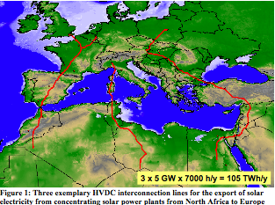
Notes:
Results of the TRANS-CSP Study. The TRANS-CSP study focuses on the interconnection of the electricity grid of Europe, the Middle East and North Africa (EUMENA) with the purpose of supplying about 15 % of the European electricity demand by solar energy imports from the South by the year 2050. The conventional electricity grid is not capable of transferring large amounts of electricity over long distances. Therefore, a combination of the conventional alternate current (AC) grid with High Voltage Direct Current (HVDC) transmission technologies will be used in such a Trans- European electricity scheme. Figure 1 shows three examples of interconnections that could be realised without causing major environmental impacts. There are several good reasons for such a transmission scheme: the huge solar energy potential of MENA can easily produce 700 TWh/y in 2050 for export, reducing significantly the European CO2-emissions, concentrating solar power plants in MENA provide around the clock firm capacity for base load, intermediate load and peak load and can complement the European renewable energy mix to provide secured power supply, a well balanced mix of national and imported renewable energy will reduce the dependency on energy imports in Europe and provide a basis for economic development in MENA, transmission losses of roughly 15 % (e.g. from Southern Algeria to Central Europe) are overcompensated by 300 % annual solar irradiance in MENA, electricity from solar thermal power plants will become the least cost option for electricity in MENA, a well balanced mix of renewables is the only guarantor for stable electricity prices, import solar electricity can be used in Europe for firm power capacity and to generate hydrogen as fuel for the transport sector. The TRANS-CSP study provides a first information base for the political framework that is required for the initiation and realisation of such a scheme. It quantifies the available solar energy resources and the expected cost of import solar electricity, a scenario of integration into the European power sector until 2050, and shows the environmental and socio-economic impacts of such a large scale infrastructure. 3 x 5 GW x 7000 h/y= 105 TWh/y Figure 1: Three exemplary HVDC interconnection lines for the export of solar electricity from concentrating solar power plants from North Africa to Europe Figure 2: Electricity supply scenario for EU 30 including solar electricity imports from Northern Africa.

Slide 23
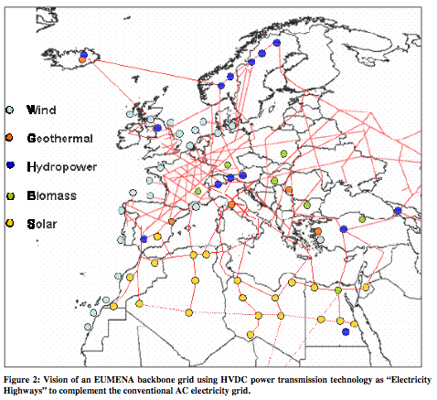
Notes:
Results of the TRANS-CSP Study. The TRANS-CSP study focuses on the interconnection of the electricity grid of Europe, the Middle East and North Africa (EUMENA) with the purpose of supplying about 15 % of the European electricity demand by solar energy imports from the South by the year 2050. The conventional electricity grid is not capable of transferring large amounts of electricity over long distances. Therefore, a combination of the conventional alternate current (AC) grid with High Voltage Direct Current (HVDC) transmission technologies will be used in such a Trans- European electricity scheme. Figure 1 shows three examples of interconnections that could be realised without causing major environmental impacts. There are several good reasons for such a transmission scheme: the huge solar energy potential of MENA can easily produce 700 TWh/y in 2050 for export, reducing significantly the European CO2-emissions, concentrating solar power plants in MENA provide around the clock firm capacity for base load, intermediate load and peak load and can complement the European renewable energy mix to provide secured power supply, a well balanced mix of national and imported renewable energy will reduce the dependency on energy imports in Europe and provide a basis for economic development in MENA, transmission losses of roughly 15 % (e.g. from Southern Algeria to Central Europe) are overcompensated by 300 % annual solar irradiance in MENA, electricity from solar thermal power plants will become the least cost option for electricity in MENA, a well balanced mix of renewables is the only guarantor for stable electricity prices, import solar electricity can be used in Europe for firm power capacity and to generate hydrogen as fuel for the transport sector. The TRANS-CSP study provides a first information base for the political framework that is required for the initiation and realisation of such a scheme. It quantifies the available solar energy resources and the expected cost of import solar electricity, a scenario of integration into the European power sector until 2050, and shows the environmental and socio-economic impacts of such a large scale infrastructure. 3 x 5 GW x 7000 h/y= 105 TWh/y Figure 1: Three exemplary HVDC interconnection lines for the export of solar electricity from concentrating solar power plants from North Africa to Europe Figure 2: Electricity supply scenario for EU 30 including solar electricity imports from Northern Africa.

Slide 24
… and the EU regulatory response
Non mandatory EU-wide transmission expansion plan prepared by ENTSO (European Network of Transmission System Operators) & ACER (Agency for the Cooperation of Energy Regulators) with stakeholders participation
First draft plan published 1 March 2010
Horizon 2010-2020: 470 projects of “European significance”, 42000 km, 25 billion € in the next 5 years
Mandatory national transmission expansion plans prepared by national TSOs & approved & enforced by national regulators
However, final decisions are left to national regulators & TSOs & the established horizon is just 10 years
Some critical issues (authorizations, siting, remuneration (Art. 22.7 & 22.8 of Regulation)) are still open

Slide 25
EU Electricity Directive & Regulation, 2009
Art. 22. Network development and powers to make investment decisions.
“Every year, transmission system operators shall submit to the regulatory authority a ten-year network development plan based on existing and forecast supply and demand after having consulted all the relevant stakeholders. …The regulatory authority shall consult all actual or potential system users on the ten-year network development plan in an open and transparent manner.”
“When elaborating the ten-year network development plan, the transmission system operator shall make reasonable assumptions about the evolution of the generation, supply, consumption and exchanges with other countries, taking into account investment plans for regional and Community-wide networks.”
Article 8(3)(b) of Regulation (EC) No 714/2009: “The ENTSO for electricity shall adopt: …a non-binding Community-wide ten-year network development plan, (Community-wide network development plan), including a European generation adequacy outlook, every two years…”

Slide 26
EU Electricity Directive & Regulation, 2009
Article 8(11) of Regulation (EC) No 714/2009: “The Agency (ACER) shall provide an opinion on the national ten year network development plans to assess their consistency with the Community-wide network development plan. If the Agency identifies inconsistencies between a national ten-year network development plan and the Community-wide network development plan, it shall recommend amending the national ten-year network development plan or the Community-wide network development plan as appropriate.”
Art. 22. Network development and powers to make investment decisions (cont.)
“The regulatory authority shall examine whether the ten-year network development plan covers all investment needs identified during the consultation process, and whether it is consistent with the non-binding Community-wide ten-year network development. …The regulatory authority may require the transmission system operator to amend its ten-year network development plan.”
“Member States shall ensure that the regulatory authority is required to take at least one of the following measures to ensure that the investment in question is made…”

Slide 27
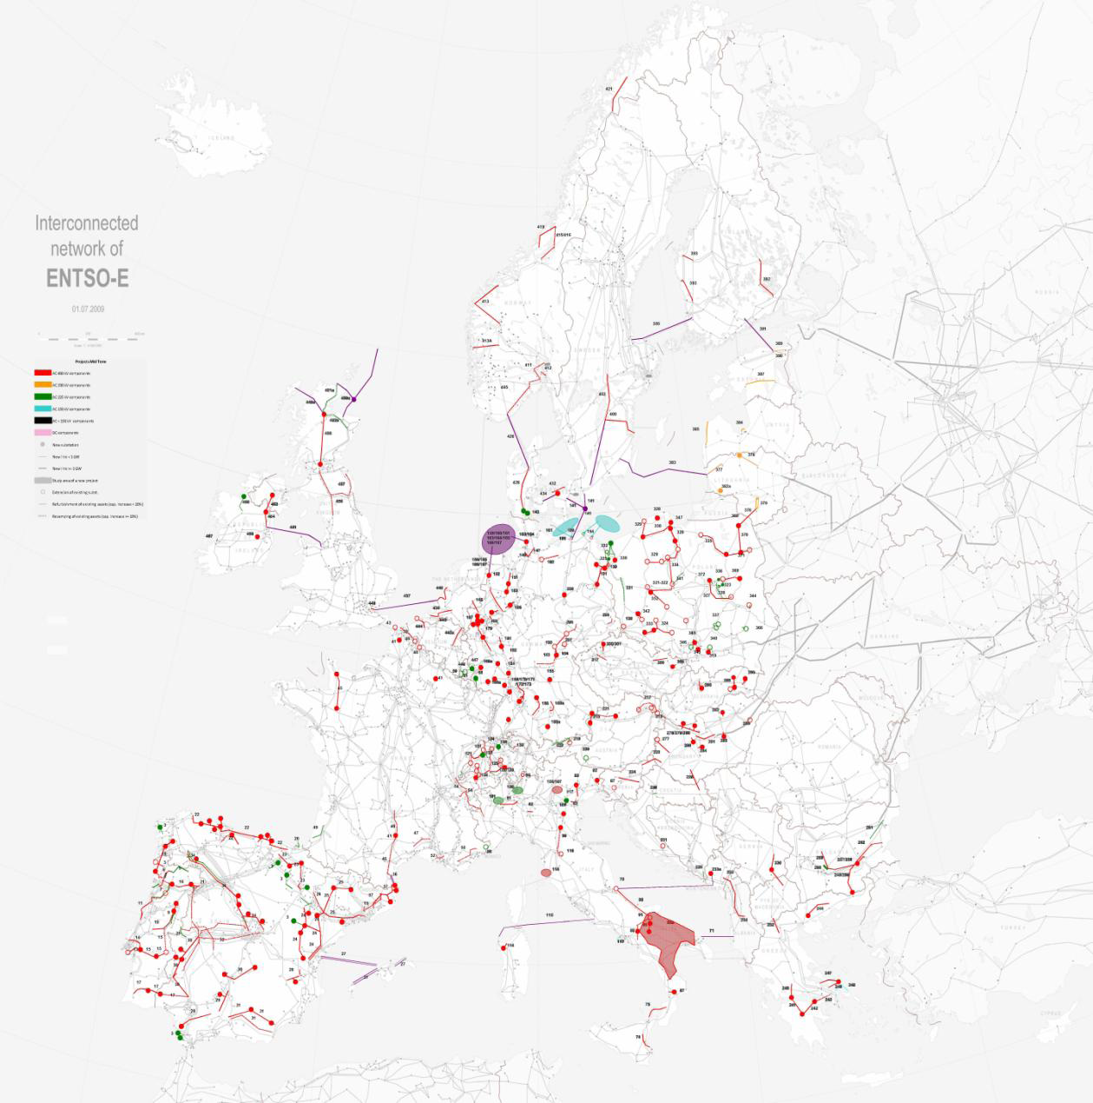
Projects of European significance (2010-2014)

Slide 28
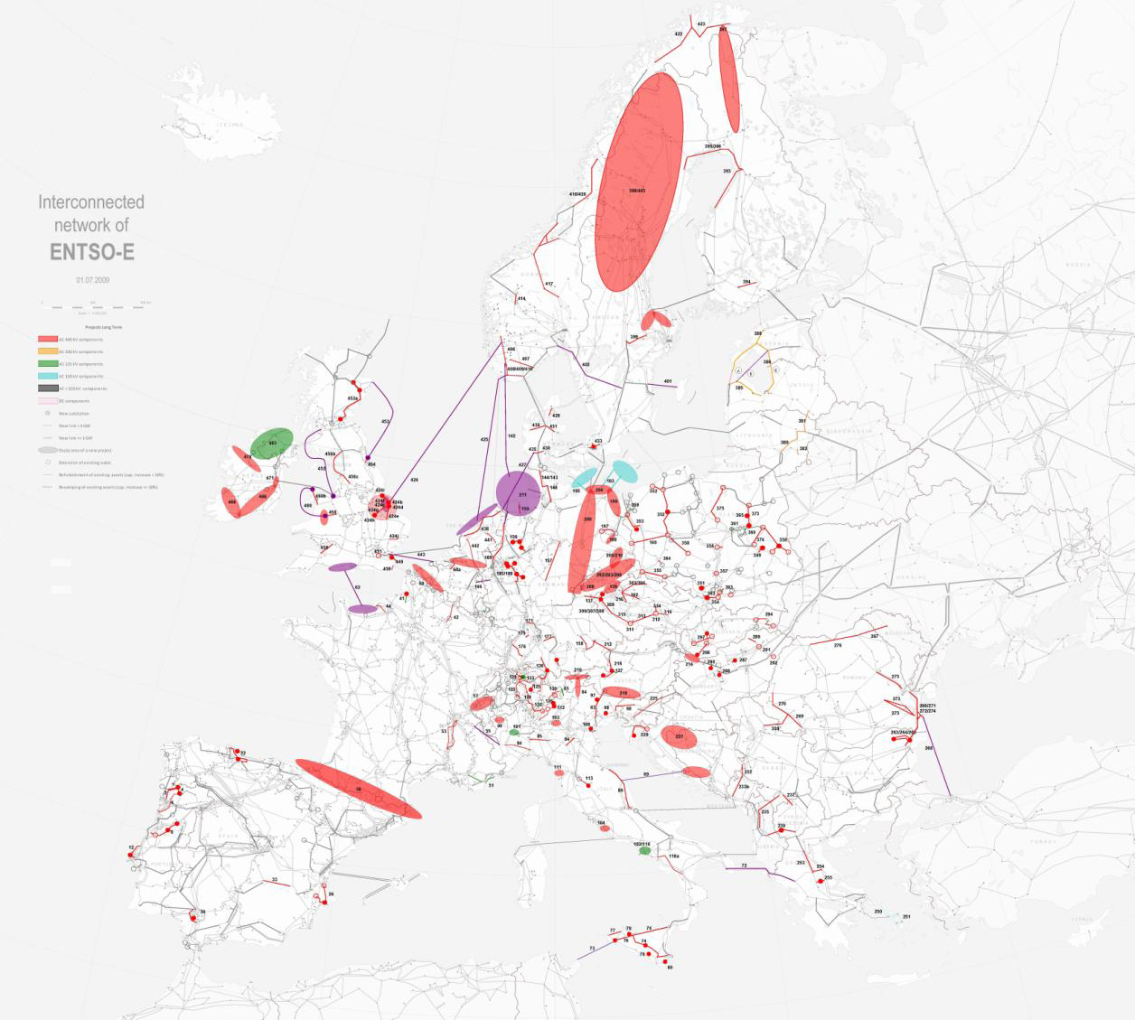
Projects of European significance (2015-2020)
Projects of European significance (2015-2020)

Slide 29
Cost allocation implicitly results from the Inter-TSO payment mechanism
Countries compensate one-another for the utilization of their networks
A procedure is needed to quantify “network utilization”
The net balance of compensations & charges for each country is added to its total network cost from which transmission tariffs are computed
The national network charge (every country is free to design these charges) gives access to the entire EU
The current method could be much improved, but it already has solved a major part of a really tough problem

Slide 30
Regional initiatives: Towards a seamless EU IEM?

Slide 31
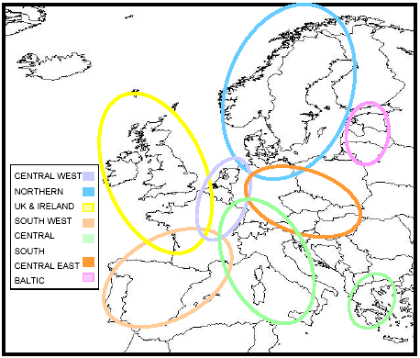
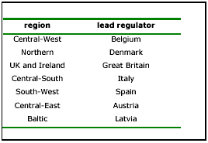
The electricity Regional Initiatives

Slide 32
Tasks being addressed by the RIs
Coordinated transmission capacity calculation & utilization of a common network model
Towards a regional single auction platform, with harmonized rules, IT interface & products for medium & long-term allocation
Towards a market coupling model for the day-ahead timeframe
Towards an intra-day mechanism, possible based on continuous trading
Integration of balancing markets
Integration of transparency requirements

Slide 33
From RIs to a true EU IEM
The magnitude of the challenge is worth noticing: coordinated congestion management at EU-wide level
7 Regional Initiatives (RIs) were created to remove barriers to trade & achieve a high level of harmonization just among neighboring countries
with the expectation of integrating the RIs into a single EU IEM later
The success has been very limited so far & the progress very slow
However, major advances have been recently made under the initiative of the Power Exchanges themselves

Slide 34
Still major open issues
EU-wide transmission planning
is only indicative
current horizon of 10 years is too short to include major sustainability concerns
There is no common EU policy on cost recovery of transmission assets
Some national approaches create unnecessary risk for investors
No use of Locational Marginal Prices (LMPs) for energy

Slide 35
The MIT Future of the Grid Study
Objective
To identify the key technical and policy challenges and opportunities that must be addressed if the electric grid is to evolve so as to enable the nation’s power system to operate efficiently, reliably, and securely despite the new demands that will be placed upon it
Considered topics include
Enhancing transmission, distribution & demand responsiveness
Communications, cyber-security & privacy
A comprehensive reference for policy-makers, especially on new technologies & T&D implications
Recommendations on issues that will require a disruptive rather than an evolutionary response
Will assess what is known, not do new research
US focus (but learn from abroad), 2030 horizon

Slide 36
Thank you for your attention

